Slide 1
IMBY
Open Data Hackathon

Slide 2
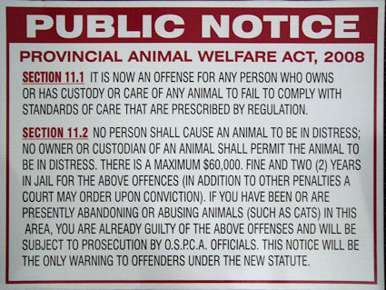
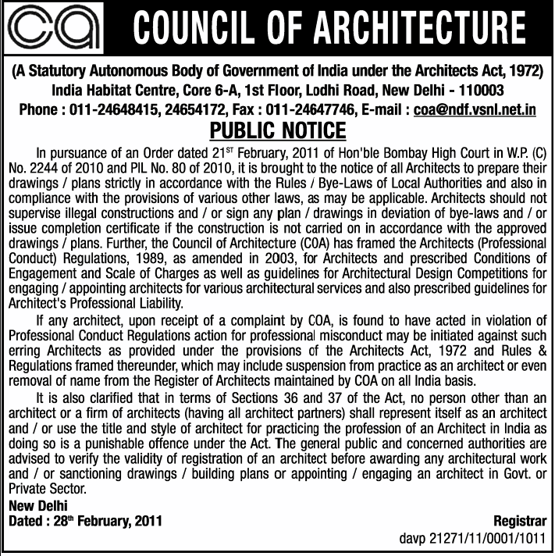
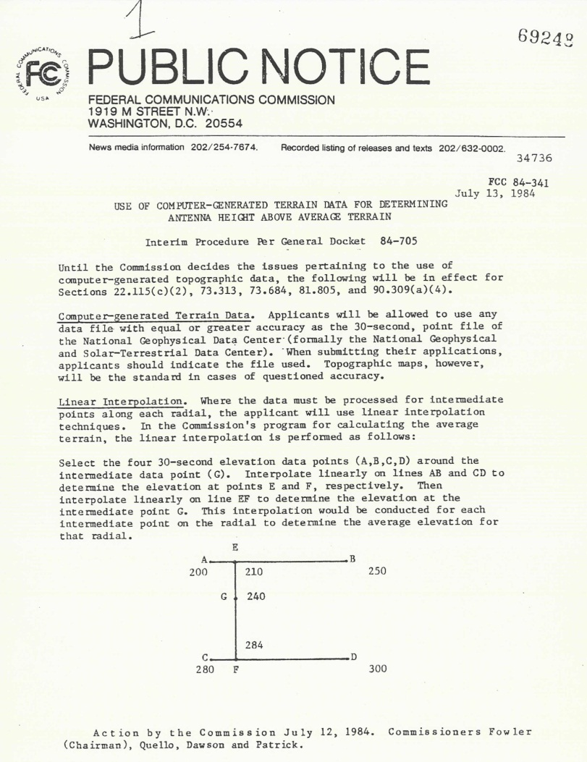
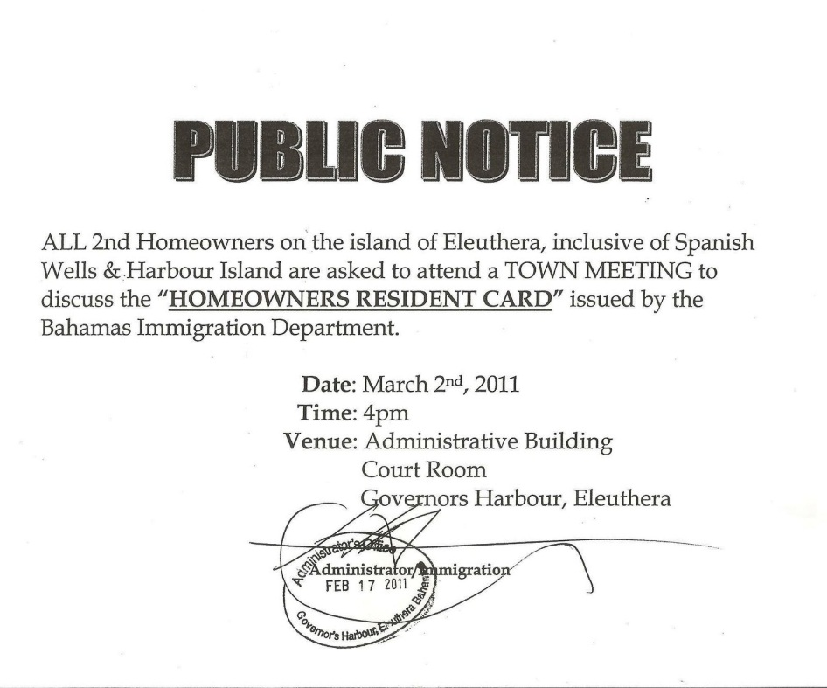
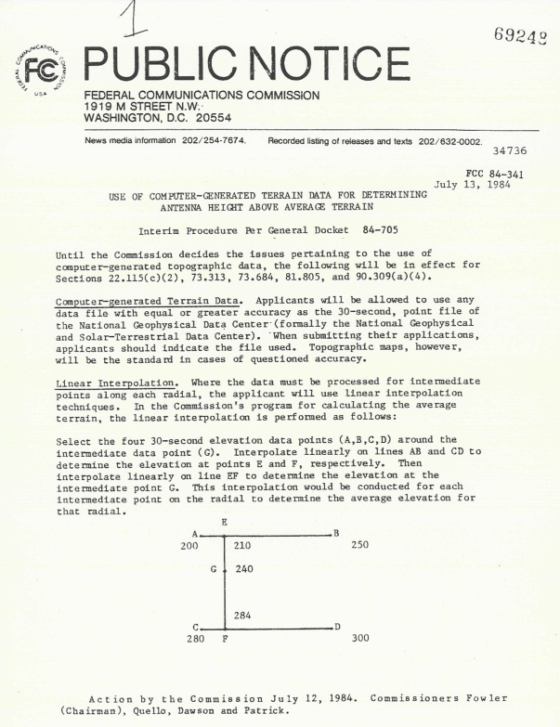
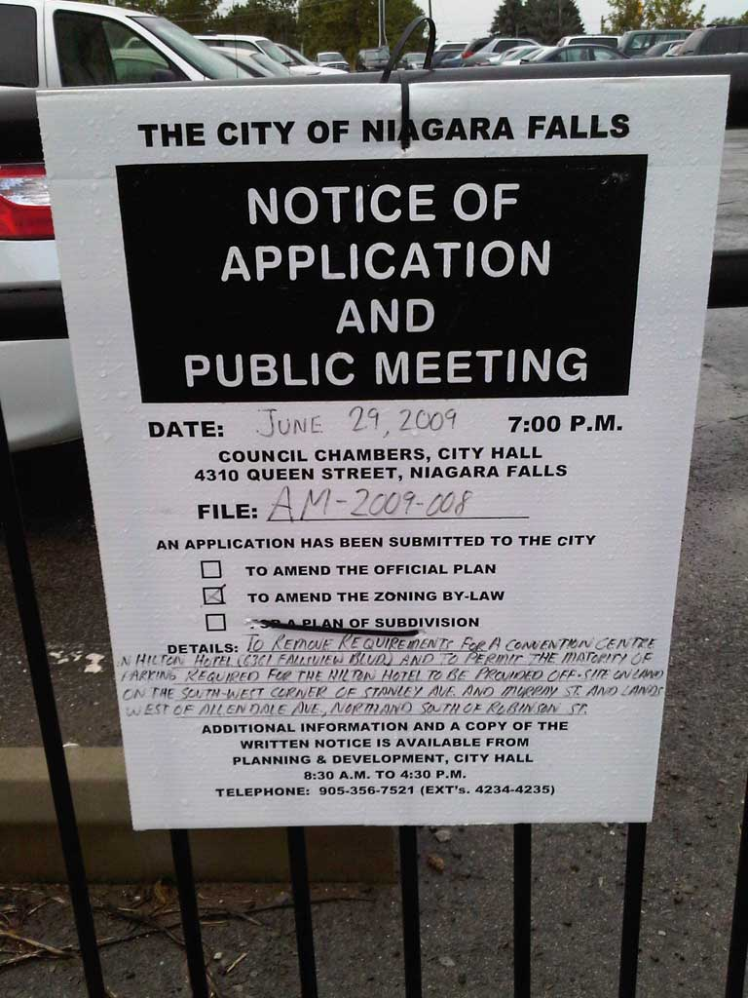

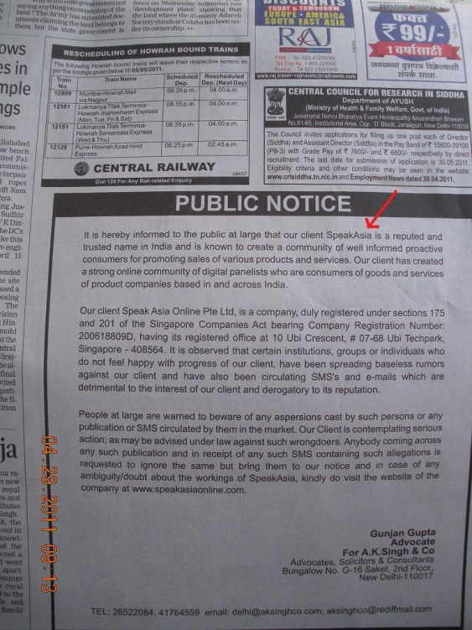
What’s going on in your back yard?

Slide 3
Issue
Lack of accessible and personally relevant information on changes in your local community
Limitations in information discovery
Difficulties soliciting genuine feedback
Antiquated communications channels

Slide 4
Solution
A web application that:
Pushes personally relevant information on infrastructure, city planning and real estate developments
Provides a channel for direct feedback to appropriate stakeholders

Slide 5
Product Demo

Slide 6
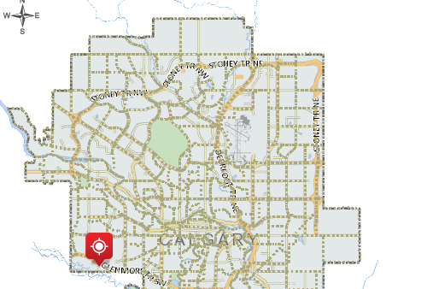
Location based search features
Naturalized location entry

Slide 7
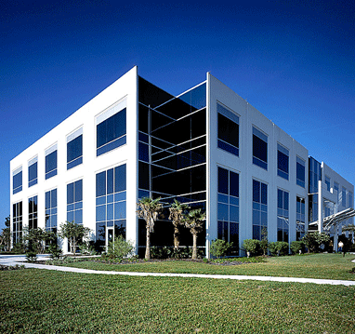
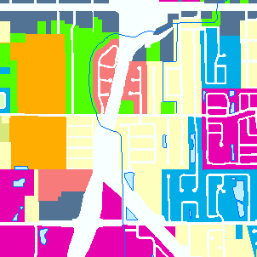

Personalized content filters for relevant data
Categorized selection of development type

Slide 8
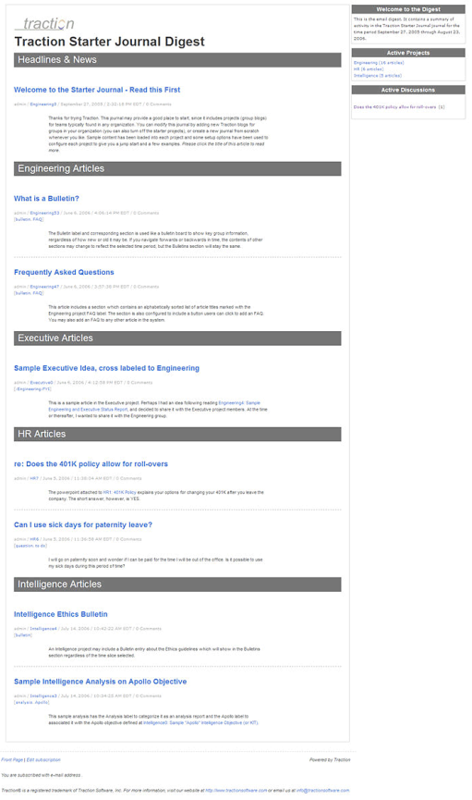

Push focused information delivery
>
Receive notification about relevant events

Slide 9
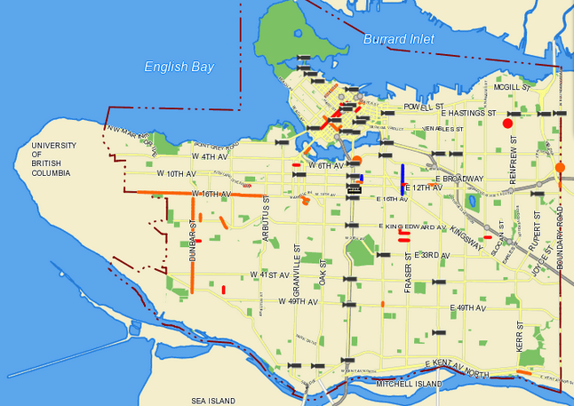
Content from open data collections
Draw from multiple sources of data

Slide 10

Facilitates user community feedback
Encourages dialogue with the relevant city officials
Generates an area for public opinion sharing

Slide 11
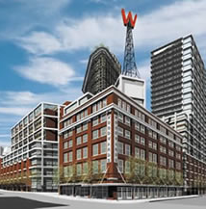
Shortcomings in Vancouver’s Open Data
Zoning Change
Applications
Development
Permit Consultations
Machine accessible
Machine updated

Slide 12
Thank You

